Slide 1

Rationale
Introduction to Windows Store App Development Using HTML5 and JavaScript
Computer science is a field of study that deals with solving a variety of problems by using computers.
  To solve a given problem by using computers, you need to design an algorithm for it.
Multiple algorithms can be designed to solve a particular problem.
An algorithm that provides the maximum efficiency should be used for solving the problem.
  The efficiency of an algorithm can be improved by using an appropriate data structure.
Data structures help in creating programs that are simple, reusable, and easy to maintain.
This module will enable a learner to select and implement an appropriate data structure and algorithm to solve a given programming problem.

Slide 2
Objectives
  In this session, you will learn to:
  Work with application events
Notes:
2

Slide 3
Working with Application Events
  During its lifecycle, when an app switches from one phase to another, an event or a series of events occurs.
Notes:
3

Slide 4
The Phases of App Lifecycle
Let us view an animation, which explains the phases of app lifecycle
Notes:
4

Slide 5
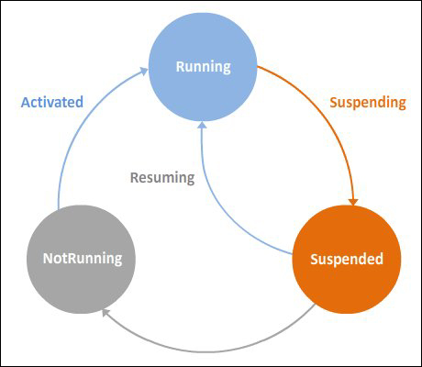
The Phases of App Lifecycle (Contd.)
  The following figure shows the app lifecycle.
Notes:
5

Slide 6


Just a Minute
  Identify the circumstance in which an app is switched to the Suspended phase.
    1. The app is idle for at least 10 seconds.
    2. A new app is launched by the user.
    3. The system is running low on resources.

Slide 7
Just a Minute (Contd.)
  Solution:
  2. A new app is launched by the user.

Slide 8
The Application Events
  Application events are defined in the WinJS.Application namespace.
  These events include:
  onactivated
  oncheckpoint
  onerror
  onloaded
  onready
  onsettings
  onunload
Notes:
8

Slide 9
Defining Handlers for Application Events
  To handle an event associated with an app, you need to define an event handler.
  An event handler is the code that needs to be executed whenever the corresponding event occurs.
  The following syntax can be used to create an event handler:
    function <FunctionName> (<EventObjectName>) { }
  The following code snippet defines an event handler named app_activated for the onactivated event of an app:
    function app_activated (args) {
    /* ToDo: Write code that will execute when the app is launched and activated.*/
    }
Notes:
9

Slide 10
Defining Handlers for Application Events (Contd.)
  To execute the app_activated event handler when the onactivated event is fired, you need to associate it with that event of the app.
  For this, the following code snippet can be used:
    WinJS.Application.onactivated = app_activated;
  Alternatively, the creation of the event handler and its association to the application event can be done in a single step by using the following code snippet:
    WinJS.Application.onactivated = function (args) {
    /*
    ToDo: Write a code that will execute when the app is launched and activated.
    */
    };
Notes:
10

Slide 11
Defining Handlers for Application Events (Contd.)
  When you create a Windows Store app project, a default.js file is created under the js folder of your project.
  Let us explore the structure of the default.js file.
Notes:
11
Explain the statements in the default.js file.

Slide 12
Just a Minute
  Which one of the following namespaces contains the definition of the application event?
    1. WinJS.Application
    2. WinJS.Application.Events
    3. WinJS.ApplicationEvents

Slide 13
Just a Minute (Contd.)
  Solution:
  1. WinJS.Application

Slide 14
Summary
  In this session, you learned that:
  After an app is deployed on a device, till its removal from the device, the application passes through the following phases:
    Running
    Suspended
    NotRunning
  Application events are defined in the WinJS.Application namespace.
Notes:
14

Slide 15

Q&A

